Slide 1
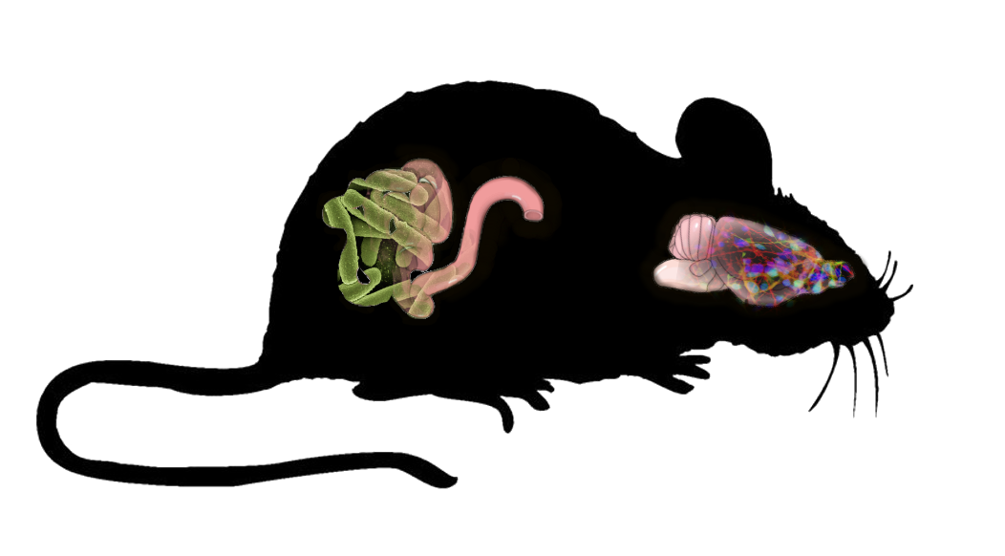
Gut Bacterial Production of a Single Metabolite Affects Anxiety and ASD-like Behaviors
Brittany Needham, PhD
Sarkis Mazmanian Lab
Caltech

Slide 2
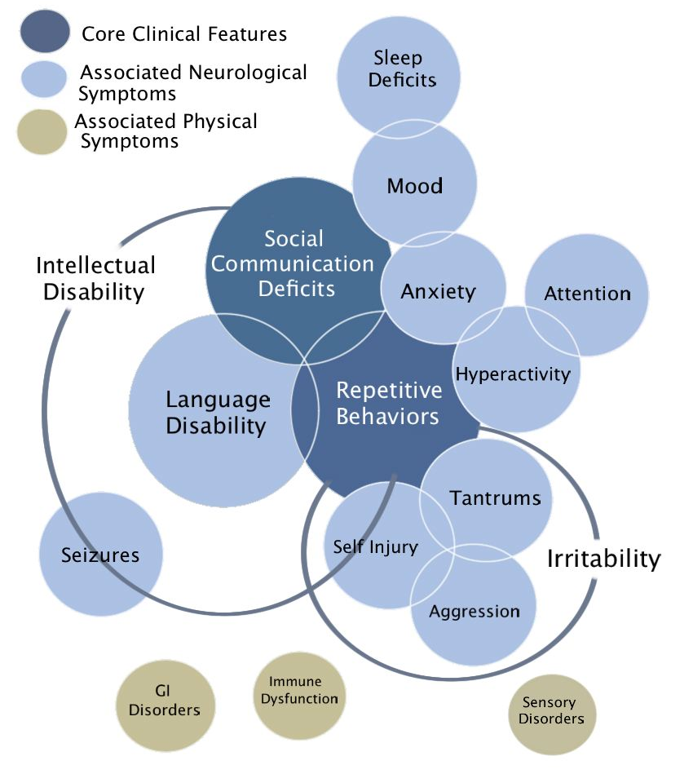
Autism Spectrum Disorder
autismspeaks.org
Notes:
Autism Spectrum Disorder. ASD is defined by social communication deficits and repetitive behaviors. Recent estimates put it at about 1 in 48 kids being diagnosed. You may have heard about it’s recent rise, the causes of which are hotly debated. Many of us in this room are probably familiar with ASD out of personal association with someone who is on the spectrum. Along with these core features, there are various comorbidities with ASD. The most common of these seen in children with ASD is anxiety, although anxiety is of course difficult to diagnose in those with severe ASD.
Several physical symptoms commonly co-occur with ASD and are particularly interesting as well. GI dysfuntion and immune dysregulation, both of which can be influenced by the microbiota, and vice versa.
In fact, populations of people with ASD do indeed have altered gut microbiota profiles.

Slide 3
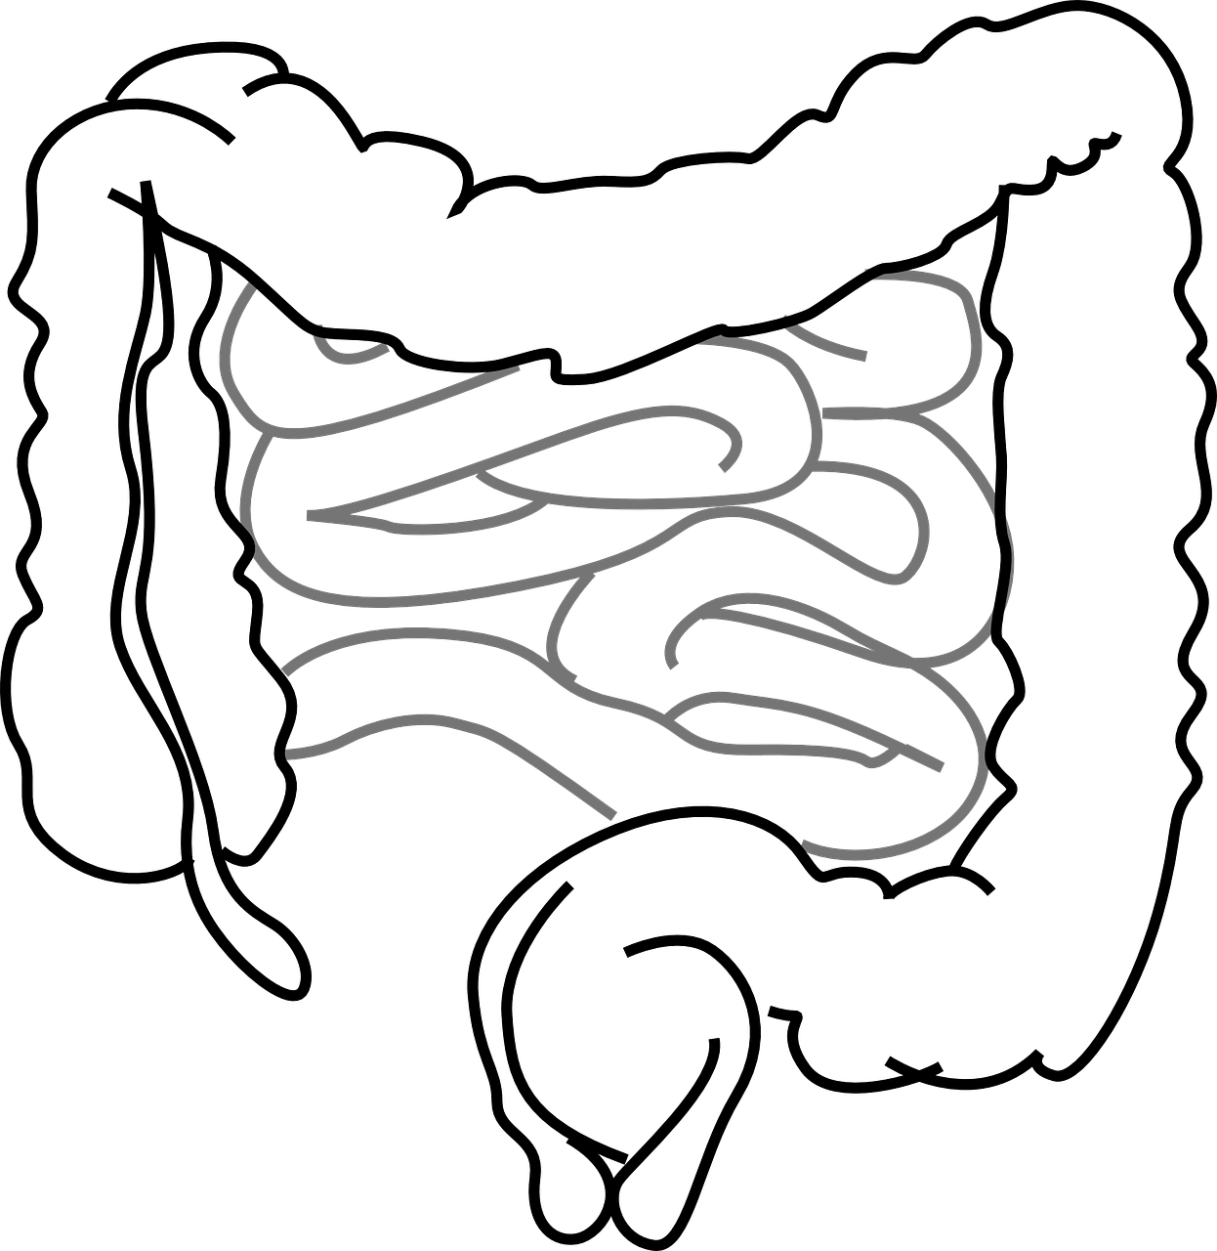
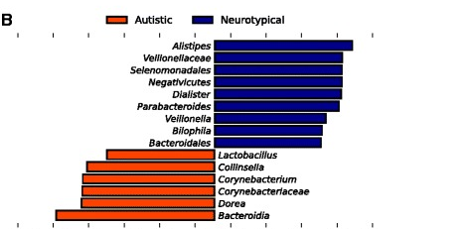
Autism Spectrum Disorder
In humans and animal models, gut microbial signatures are altered
Autistic
Neurotypical
Alistipes
Vellionellaceae
Selenomonadales
Negativicutes
Dialister
Parabacteroides
Veillonella
Bilophila
Bacteroidales
Lactobacillus
Callinsella
Corynebacterium
Corynebacteriaceae
Dorea
Bacteroidia
LDA SCORE
Strati et al 2017
autismspeaks.org
Notes:
Autism Spectrum Disorder. ASD is defined by social communication deficits and repetitive behaviors. Recent estimates put it at about 1 in 48 kids being diagnosed. You may have heard about it’s recent rise, the causes of which are hotly debated. Many of us in this room are probably familiar with ASD out of personal association with someone who is on the spectrum. Along with these core features, there are various comorbidities with ASD. The most common of these seen in children with ASD is anxiety, although anxiety is of course difficult to diagnose in those with severe ASD.
Several physical symptoms commonly co-occur with ASD and are particularly interesting as well. GI dysfuntion and immune dysregulation, both of which can be influenced by the microbiota, and vice versa.
In fact, populations of people with ASD do indeed have altered gut microbiota profiles.

Slide 4
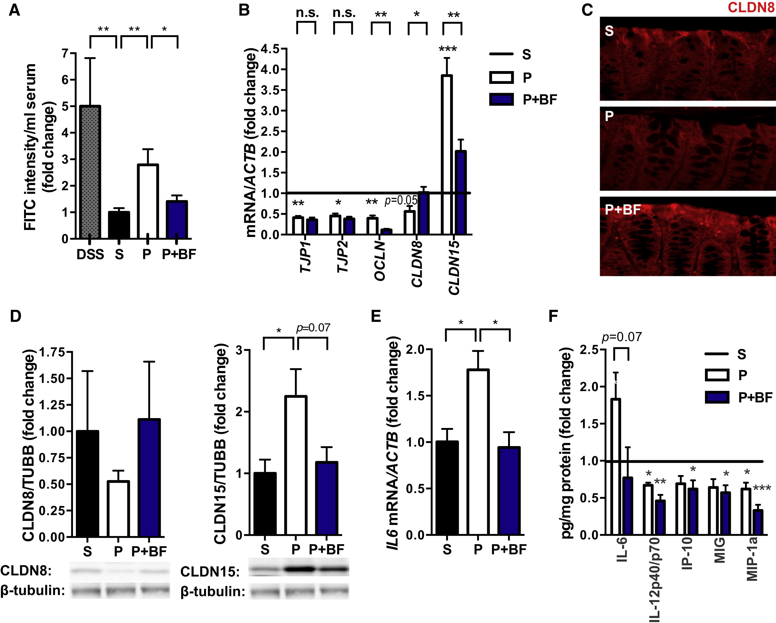
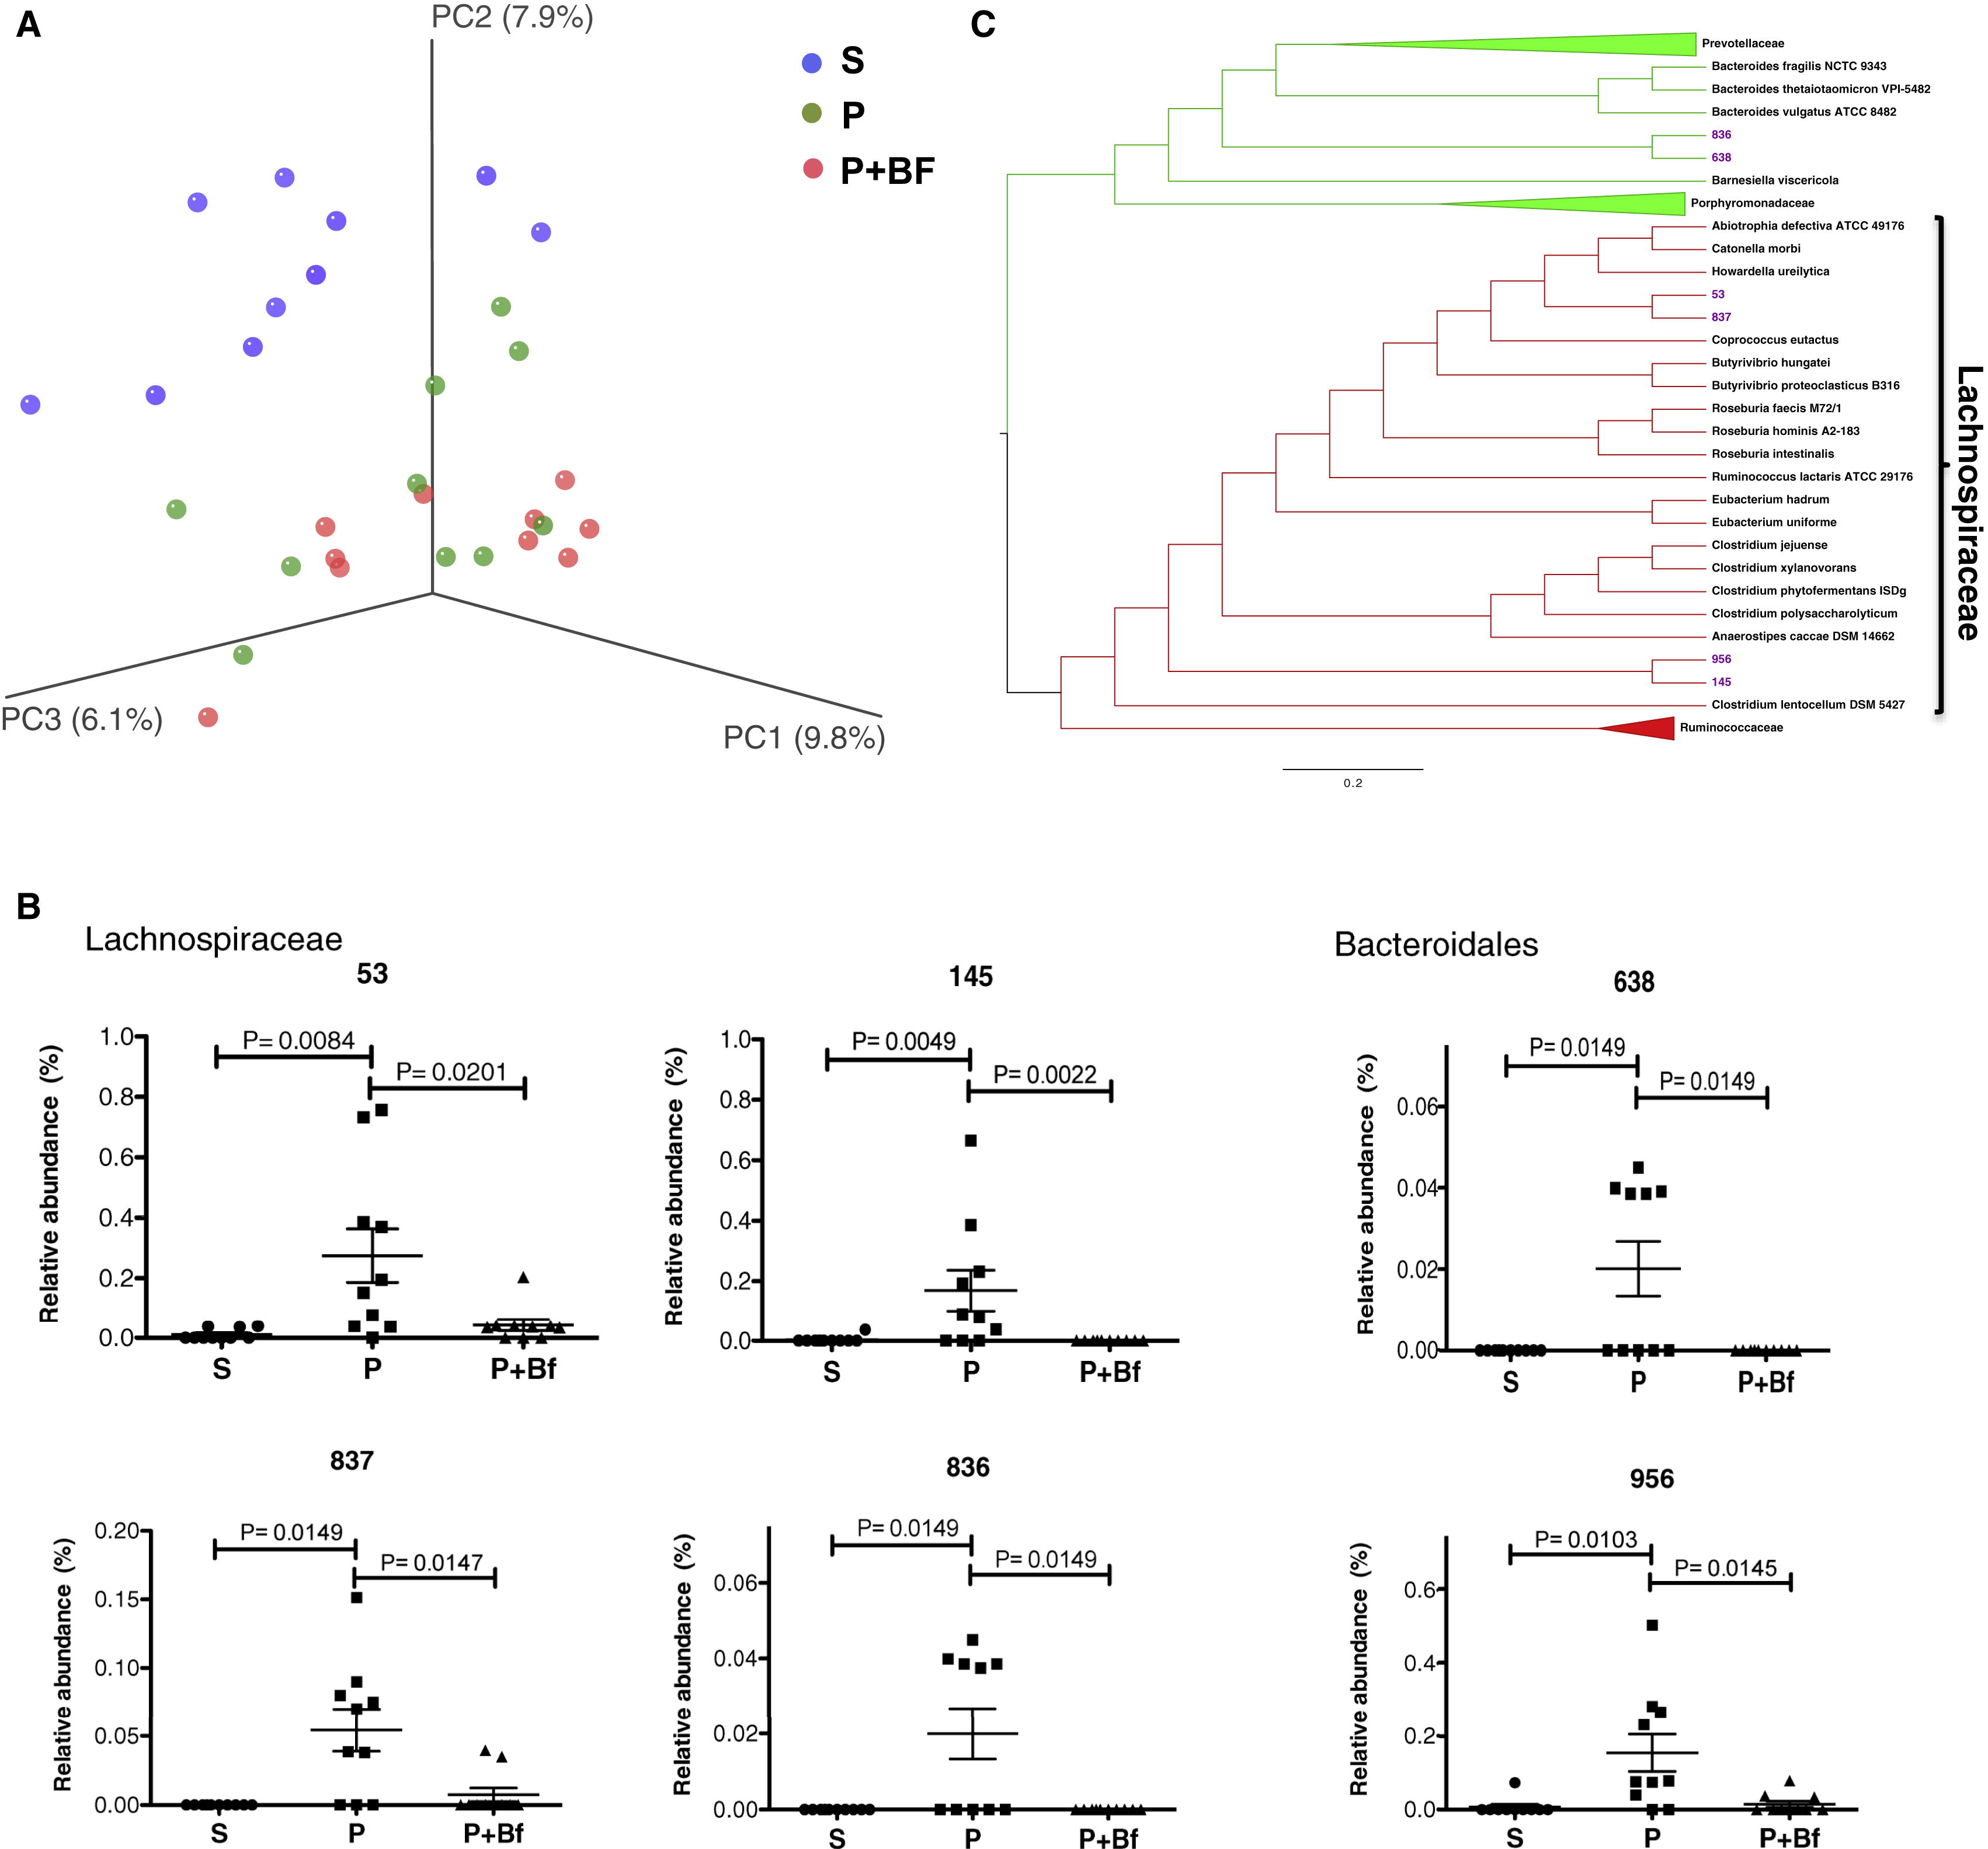
Mouse Model of ASD: Maternal Immune Activation (MIA)
Notes:
MIA model
-how it works
-what happened
-bfrag helps it
-metabolomics

Slide 5
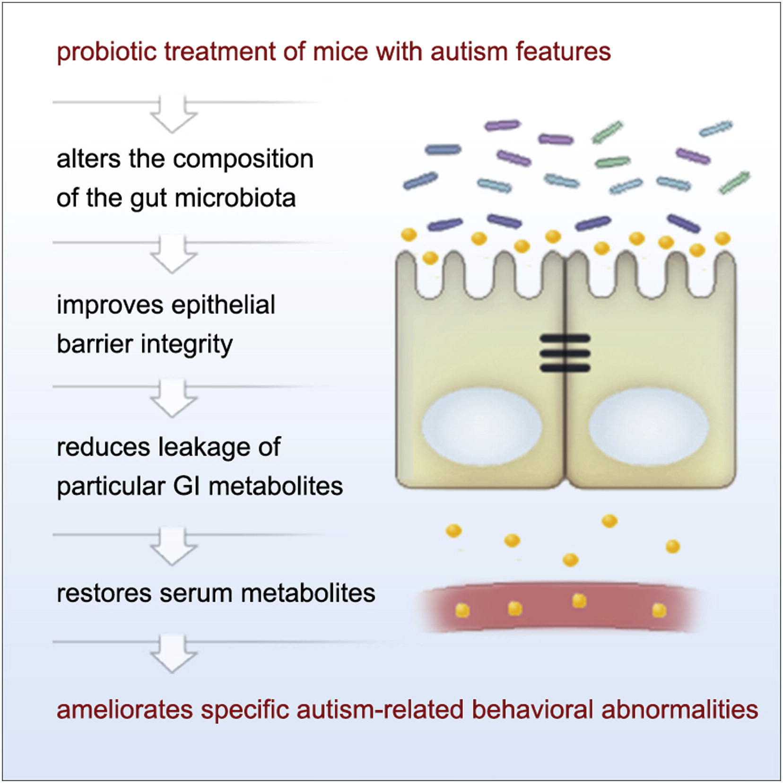
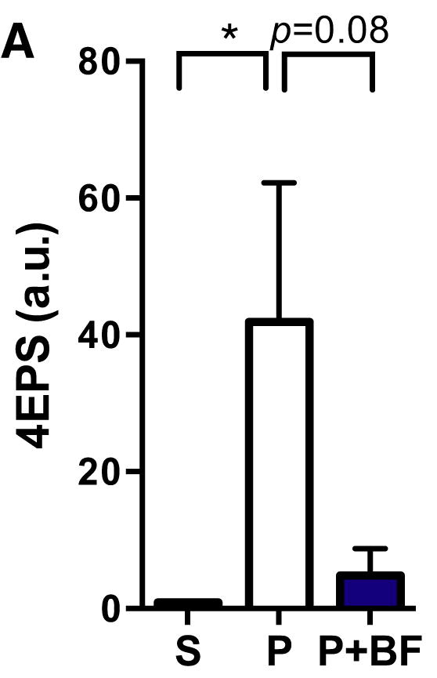
Metabolites in a mouse model of ASD
Notes:
A few years ago when she was in our lab, Elaine Hsiao identified a highly elevated metabolite, 4ethylphenylsulfate, 4EPS. When the pure molecule was injected in to mice, it seemed to cause some anxiety behavior.

Slide 6
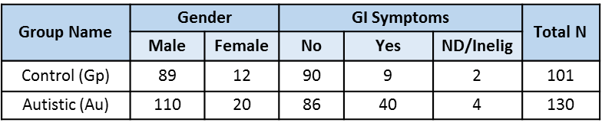
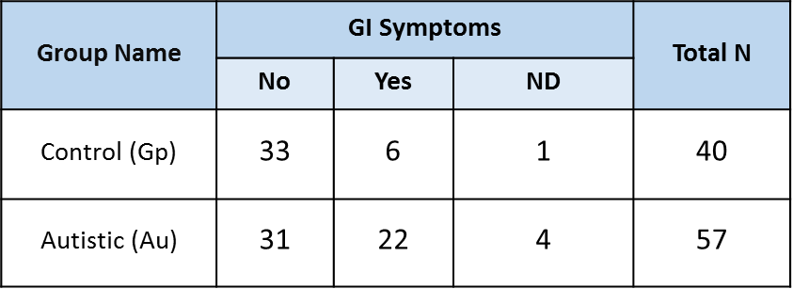
CHARGE samples (Childhood Autism Risks from Genetics and Environment
Plasma samples
All Au/All Gp
plasma
feces
Fecal samples
Paul Ashwood, Destanie Rose
Notes:
Samples analyzed in the present study were initially obtained as part of the “Childhood Autism Risk from Genetics and the Environment” (CHARGE) study conducted at the University of California at Davis. Details are published elsewhere (Hertz-Picciotto, 2006), but a brief description is as follows:
Trial objectives: to understand the interplay between environmental exposures and endogenous susceptibility factors (Figure 1)
Initiated in 2003 and has enrolled >1000 subjects in 3 groups: Children with autism, children with development delays but not autism, and neurotypical (NT) children
All subject enrolled were between the ages of 2-12 years old
Subjects had to born in California and within the catchment area of a specified list of centers in California
Phenotypic characterization was extensive (table 1), including medical records, questionnaires and biosamples including blood, urine, and hair.
However, direct assessments of anxiety, current GI symptom severity (vs. GI history), and intestinal permeability were NOT included

Slide 7
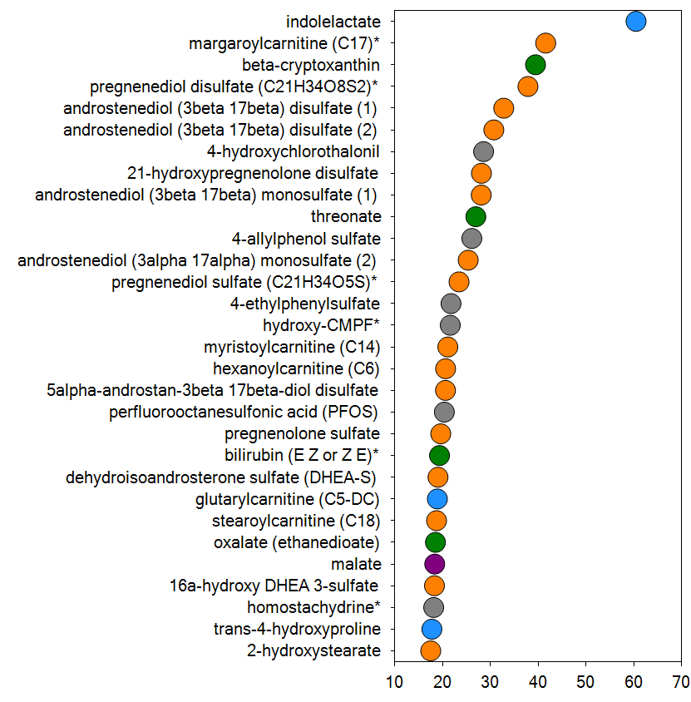
4EPS is elevated in plasma of children with ASD
Human Plasma
Biochemical Importance Plot
4EPS levels log₁₀
Increasing Importance to Group Separation
NT
ASD
mean-decrease-accuracy
Metabolon
Notes:
Finally, in order to see if 4EPS is relevant to humans and other models, we did untargeted metabolomics on an ASD cohort of children and a nonhuman primate model.
We analyzed 231 human neurotypical or ASD plasma and fecal samples and 24 rhesus macaques samples of various tissue types. We found that 4EPS is significantly higher in the human plasma samples of children with ASD, and that 4EPS is one of the top 30 metabolites identified as most distinguishing in a random forest analysis. Although not significant, possibly because of low percent fill, there is also a trend of elevation in human feces and NHP plasma, cerebral spinal fluid, and gut mucosal scrapings.
We see it in 22% of the nonhuman primate CSF samples

Slide 8
4EPS is elevated in plasma of children with ASD and possibly nonhuman primates
Plasma
Biochemical Importance Plot
Feces
Humans
4EPS levels log₁₀
4EPS levels log₁₀
Increasing Importance to Group Separation
NT
ASD
NT
ASD
mean-decrease-accuracy
Metabolon
Plasma
CSF
Mucosal Scrapings
Nonhuman
Primates
4EPS levels
4EPS levels
4EPS levels
+
+
+
+
+
+
Control
ASD
Control
ASD
Control
ASD
Destanie Rose, Paul Ashwood, Human CHARGE samples
Melissa Bauman, Primate samples
Notes:
Finally, in order to see if 4EPS is relevant to humans and other models, we did untargeted metabolomics on an ASD cohort of children and a nonhuman primate model.
We analyzed 231 human neurotypical or ASD plasma and fecal samples and 24 rhesus macaques samples of various tissue types. We found that 4EPS is significantly higher in the human plasma samples of children with ASD, and that 4EPS is one of the top 30 metabolites identified as most distinguishing in a random forest analysis. Although not significant, possibly because of low percent fill, there is also a trend of elevation in human feces and NHP plasma, cerebral spinal fluid, and gut mucosal scrapings.
We see it in 22% of the nonhuman primate CSF samples

Slide 9
4EPS levels appear to be linked to microbiota, but do not always transfer to mice
Notes:
I show this at this meeting because I think it highlights some of the problems we all still face in this field and also some of the technologies that have been developed to answer questions like this- what bacteria or groups of bacteria transfer to mice from human samples and stably colonize? Which bacteria or groups of bacteria are capable and responsible for production of this particular metabolite?

Slide 10
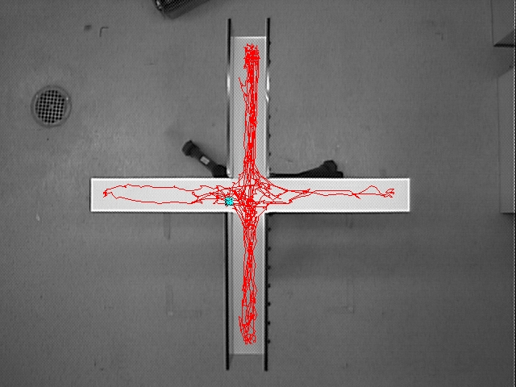
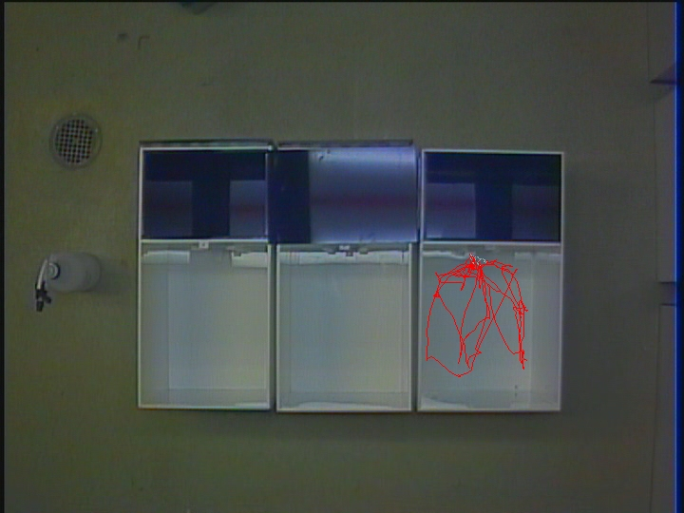
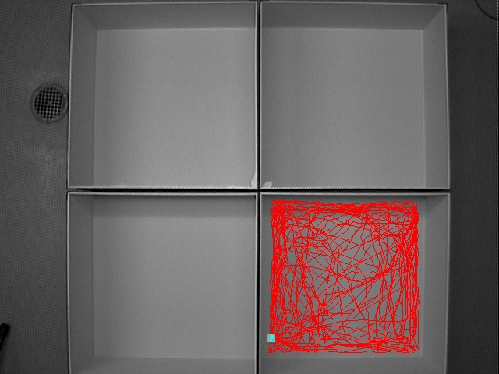
Injected 4EPS causes an anxiety phenotype
Elevated plus maze
Light/Dark Box
Open Field Arena
Notes:
injected 4EPS causes mice to display anxiety-like behavior in several tests. Shown as a black bar for the control group and injected 4eps in red on the right bar, So in the elevated plus maze, where mice can explore a protected closed arm or venture out to the open arm, and even go all the way to the end of the open arm, 4EPS injected mice spend less time in the open arm and even less at the terminus. Similarly in the light dark box assay, 4EPS injection resulted in a decrease in exploration of the open, light area as opposed to the covered, dark box. And then I also confirmed that mice spend less time in the vulnerable center of an open field arena.

Slide 11
Injected 4EPS causes an anxiety phenotype
Elevated plus maze
Seconds
Seconds
Saline
4EPS
Saline
4EPS
Light/Dark Box
Events
Seconds
Saline
4EPS
Saline
4EPS
Open Field Arena
Seconds
cm
Saline
4EPS
Saline
4EPS
Notes:
injected 4EPS causes mice to display anxiety-like behavior in several tests. Shown as a black bar for the control group and injected 4eps in red on the right bar, So in the elevated plus maze, where mice can explore a protected closed arm or venture out to the open arm, and even go all the way to the end of the open arm, 4EPS injected mice spend less time in the open arm and even less at the terminus. Similarly in the light dark box assay, 4EPS injection resulted in a decrease in exploration of the open, light area as opposed to the covered, dark box. And then I also confirmed that mice spend less time in the vulnerable center of an open field arena.

Slide 12
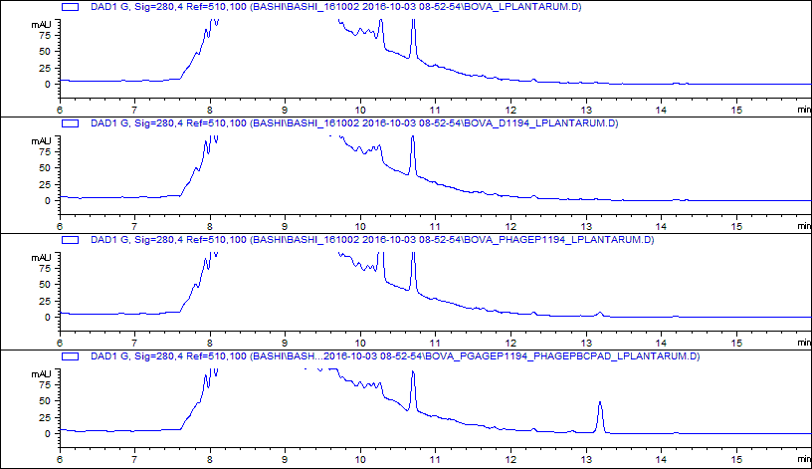
Bacterial strains can be engineered to produce 4EP
Bacteroides ovatus
Lactobacillus plantarum
Tyrosine
PAD
(B. subtilis)
Sulfated by host
BO_1194
?
P- coumaric acid
4-vinylphenol
4-ethylphenol
In vivo 4EP production
(4EPS measured here)
In vitro 4EP production
4EP
Mutant BO + LP
△4EP
4EP+
Eng. BO + LP
△4EP
4EP+
Masanori Funabashi, Michael Fischbach
Notes:
To explore the link between the gut bacterial production of this molecule and behavior, Masa Funabashi who was in Michael Fischbach’s lab, and is here at the conference, did a ton of work to identify the pathway of 4EPS synthesis. tyrosine can be converted to 4EthylPhenol (4EP) by bacteria in the gut and once it gets in to the host it is sulfated. So Masa engineered two bacterial pairs. Both isogenic pairs are bacteroides ovatus and lactobacillus plantarum together, but one has the 4EP pathway overexpressed and one has it knocked out. 4EP production occurs in vitro as well as in vivo appropriately according to whether it’s the mutant pair or the engineered pair.

Slide 13
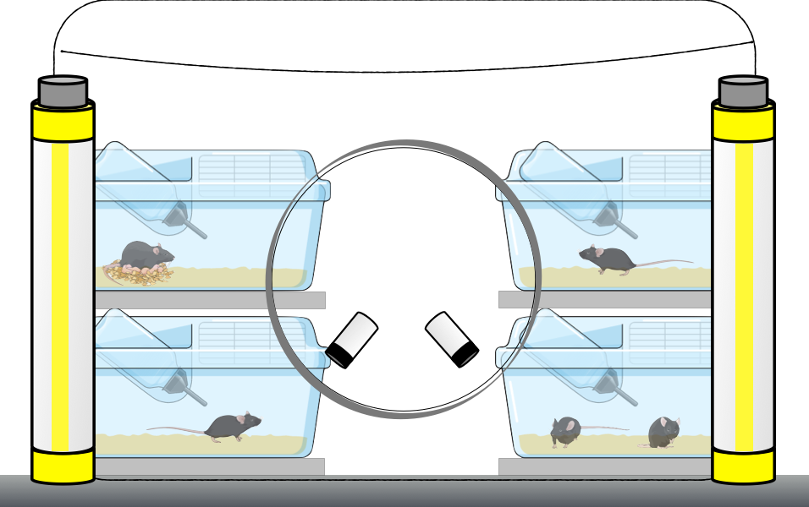
4EP+ colonized mice exhibit anxiety behaviors
Elevated plus maze
Colonize by gavage at 3wks
Behavior test from 6-8 weeks
Light/Dark Box
Open Field Arena
Notes:
And when we colonized germ-free mice with these engineered strains, they act differently! Even though they theoretically differ in only the production of this one metabolite! colonizing mice with isogenic pairs of bacteria that differ only (hopefully) in the production of 4EPS levels is sufficient to alter behavior of the animals!
So GF mice were colonized at weaning and behavior tested at adulthood, and we see that in the same three behavior tests I just showed you with the 4EPS injections,. In the elevated plus maze, the light dark box, and the open field, 4EP+ colonized mice spend less time in the more exposed regions.

Slide 14
4EP+ colonized mice exhibit anxiety behaviors
Ratio of time spent in open arm vs closed arm
Open
Terminus
Elevated plus maze
Colonize by gavage at 3wks
Behavior test from 6-8 weeks
Ratio
△4EP
4EP+
△4EP
4EP+
Tendency to explore light box
Time spent in center
Frequency
Total duration
Center vs wall
Distance
Light/Dark Box
Open Field Arena
Ratio
△4EP
4EP+
△4EP
4EP+
△4EP
4EP+
△4EP
4EP+
Notes:
And when we colonized germ-free mice with these engineered strains, they act differently! Even though they theoretically differ in only the production of this one metabolite! colonizing mice with isogenic pairs of bacteria that differ only (hopefully) in the production of 4EPS levels is sufficient to alter behavior of the animals!
So GF mice were colonized at weaning and behavior tested at adulthood, and we see that in the same three behavior tests I just showed you with the 4EPS injections,. In the elevated plus maze, the light dark box, and the open field, 4EP+ colonized mice spend less time in the more exposed regions.

Slide 15
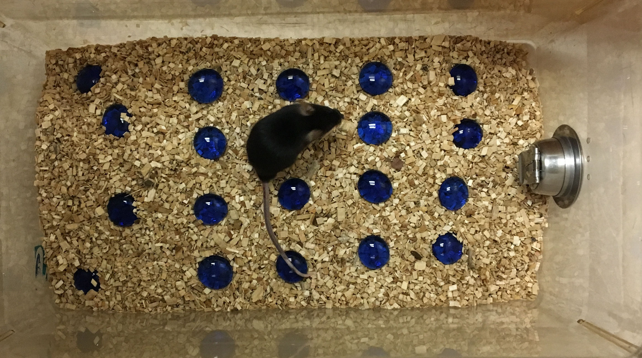
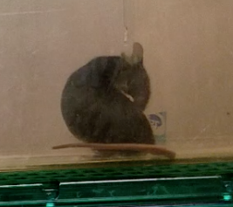
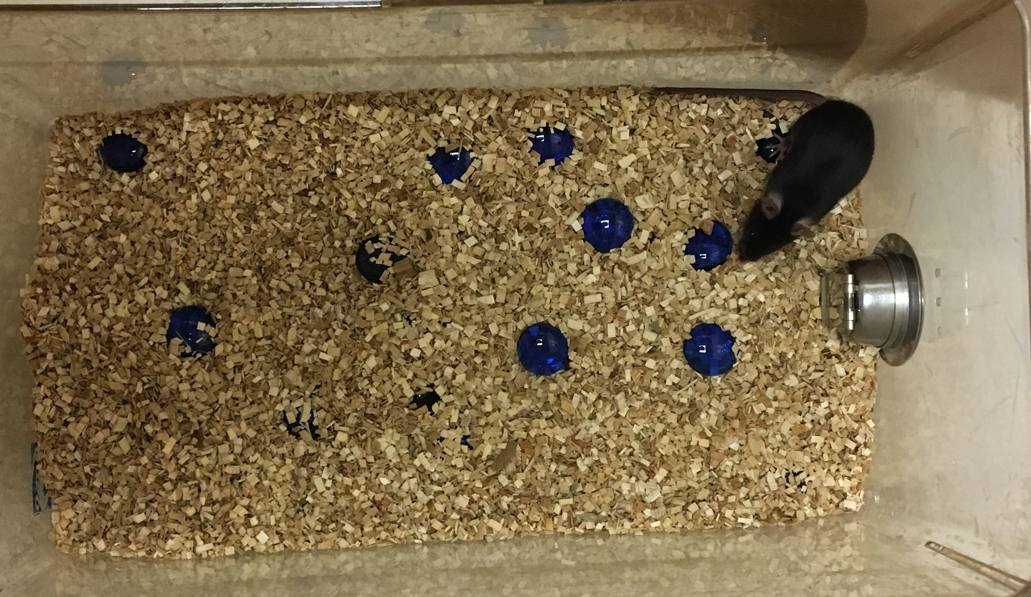
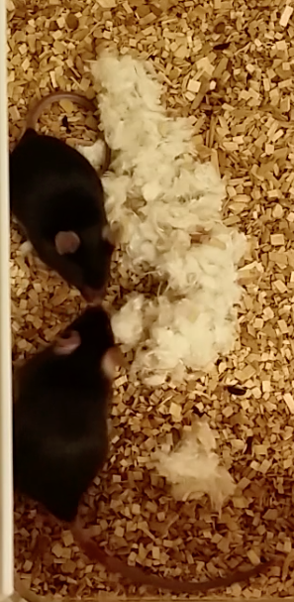
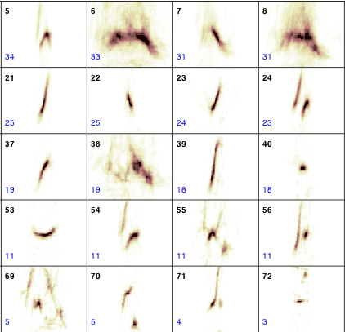
4EPS behavioral effects may extend beyond anxiety
Marble burying
Grooming
Ultrasonic Vocalizations (USV)
Social Interactions
Allison Knoll, Pat Levitt
Notes:
We’ve now expanded to look, at ASD behavior and have seen some effects here as well. 4EPS mice have increased repetitive behaviors in marble burying and grooming tests. And although these results are still preliminary, there seems to be a decrease in adult ultrasonic vocalizations, and some alterations in the amount and type of social behavior the mice tend to engage in.

Slide 16
4EPS behavioral effects may extend beyond anxiety
Marble burying
Grooming
Marbles Buried
△4EP
4EP+
△4EP
4EP+
Ultrasonic Vocalizations (USV)
Direct Social Interactions (DSI)
% time social
% Anogenital
Allison Knoll, Pat Levitt
△4EP
4EP+
△4EP
4EP+
△4EP
4EP+
Notes:
We’ve now expanded to look, at ASD behavior and have seen some effects here as well. 4EPS mice have increased repetitive behaviors in marble burying and grooming tests. And although these results are still preliminary, there seems to be a decrease in adult ultrasonic vocalizations, and some alterations in the amount and type of social behavior the mice tend to engage in.

Slide 17
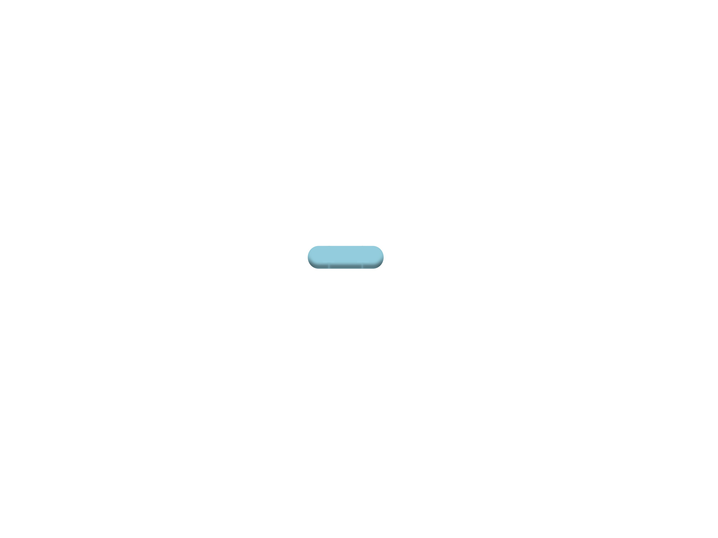
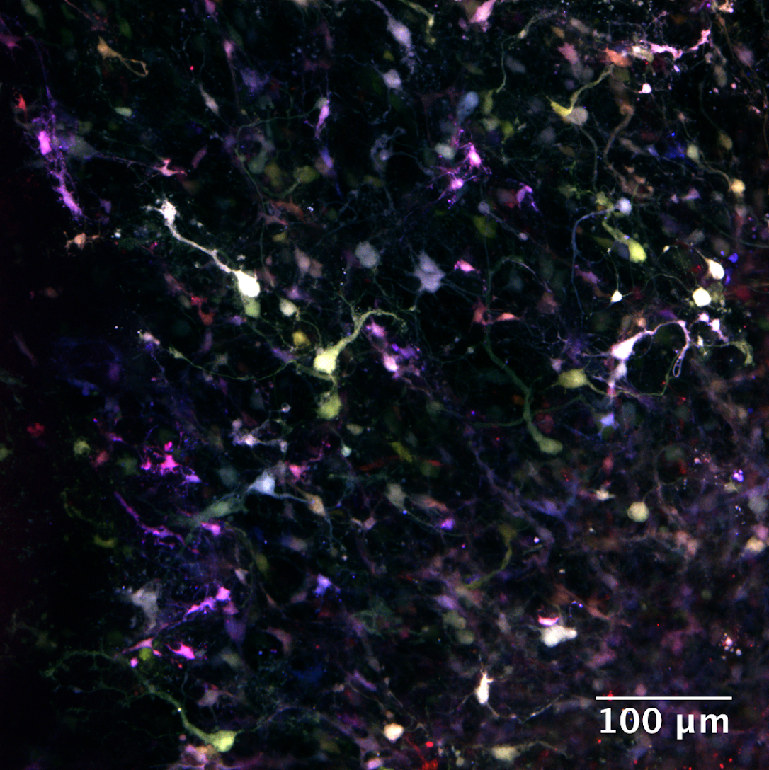
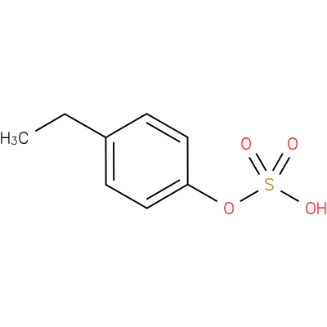

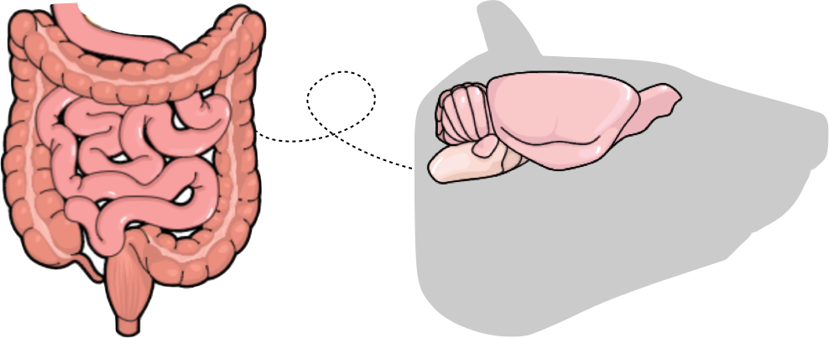
Selective metabolite production
Altered neuronal activation
By what mechanism does a molecule produced by gut bacteria affect behavior?
4EPS
Gut
Brain
Notes:
We are very interested to know how this is happening. we know how it’s possible for bacteria to make 4EP, and we know that behavior changes, and we are now working on figuring out the mechanism in between those opposite ends. We have been approaching it from both sides.

Slide 18
4EP is activated upon sulfation by SULT1A1
Bacteroides ovatus
Lactobacillus plantarum
Tyrosine
PAD
(B. subtilis)
Sulfated by host
BO_1194
?
P- coumaric acid
4-vinylphenol
4-ethylphenol
Notes:
First, we know the host sulfates 4EP into 4EPS, and this step might be required for activation for the behavioral phenotypes we are seeing, judging from injection data shown at the top in the elevated plus maze assay, where 4EPS causes a more significant phenotype when injected than 4EP or a related molecule pcresol. Sulfation of molecules is a normal detoxification pathway in the liver, but colon, small intestine and brain tissue can modify it as well as seen in this sulfation assay, and we’ve confirmed that sulfotransferase 1A1 is sufficient for this activity, shown here where 4EP is provided as substrate and then the sulfated form is quantified. pCresol here is a positive control for this reaction.

Slide 19
4EP is activated upon sulfation by SULT1A1
Bacteroides ovatus
Lactobacillus plantarum
Tyrosine
PAD
(B. subtilis)
Sulfated by host
BO_1194
?
P- coumaric acid
4-vinylphenol
4-ethylphenol
Tissue sulfation of 4EP
SULT1A1 activity
**
*
**
*
*
**
***
**
Rel. units
Saline
4EPS
4EP
PC
Cntrl
Brain
Colon
Liver
SI
4EP
PC
None
No
Enzyme
Substrate
Notes:
First, we know the host sulfates 4EP into 4EPS, and this step might be required for activation for the behavioral phenotypes we are seeing, judging from injection data shown at the top in the elevated plus maze assay, where 4EPS causes a more significant phenotype when injected than 4EP or a related molecule pcresol. Sulfation of molecules is a normal detoxification pathway in the liver, but colon, small intestine and brain tissue can modify it as well as seen in this sulfation assay, and we’ve confirmed that sulfotransferase 1A1 is sufficient for this activity, shown here where 4EP is provided as substrate and then the sulfated form is quantified. pCresol here is a positive control for this reaction.

Slide 20
4EPS can be detected in the brain (in addition to serum, urine, etc)
Brain 4EPS following IP injection
Brain 4EPS following gavage with 4EP
Probenecid
+
+
-
4EPS
-
+
+
Notes:
First, we know the host sulfates 4EP into 4EPS, and this step might be required for activation for the behavioral phenotypes we are seeing, judging from injection data shown at the top in the elevated plus maze assay, where 4EPS causes a more significant phenotype when injected than 4EP or a related molecule pcresol. Sulfation of molecules is a normal detoxification pathway in the liver, but colon, small intestine and brain tissue can modify it as well as seen in this sulfation assay, and we’ve confirmed that sulfotransferase 1A1 is sufficient for this activity, shown here where 4EP is provided as substrate and then the sulfated form is quantified. pCresol here is a positive control for this reaction.

Slide 21
Particular brain regions are activated by 4EP exposure
CeA
DMH
BLA
Amygdala
VMH
Hypothalamus
Higher in 4EP+
Lower in 4EP+
Zhuo Wang, Daniel Holschneider, USC
Notes:
we injected a radiolabeled brain activation tracer in to mice co-colonized with 4EP+ or 4EP- bacteria and placed them in an open field arena during uptake of the tracer. Shown here is the comparison between the two groups of mice, with each statistically significant pixel colored in red if it’s higher in 4EP+ mice and lower in blue. the amygdala and the hypothalamus, which are both known to be related to anxiety are more active in the 4EP+, anxious mice.
Approaching from the brain end of the mechanism, with the help of Zhuo Wang and Daniel Holschneider at USC, we injected a radiolabeled brain activation tracer in to mice co-colonized with 4EP+ or 4EP- bacteria and placed them in an open field arena during uptake of the tracer. Shown here is the comparison between the two groups of mice, with each statistically significant pixel colored in red if it’s higher in 4EP+ mice and lower in blue. As you can see the amygdala and the hypothalamus, which are both known to be related to anxiety and some of the other behavior’s I’ve mentioned are more active in the 4EP+, anxious mice.

Slide 22
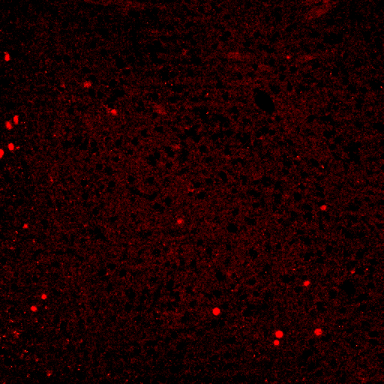
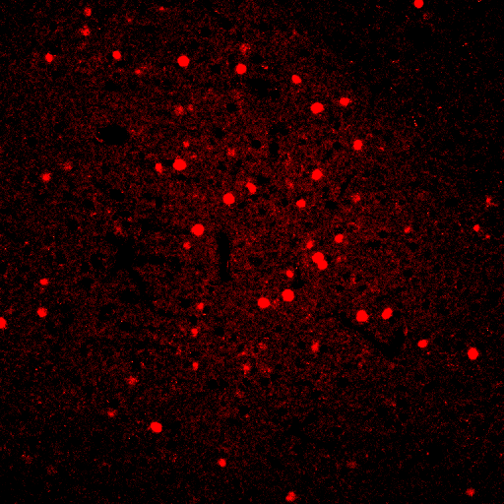
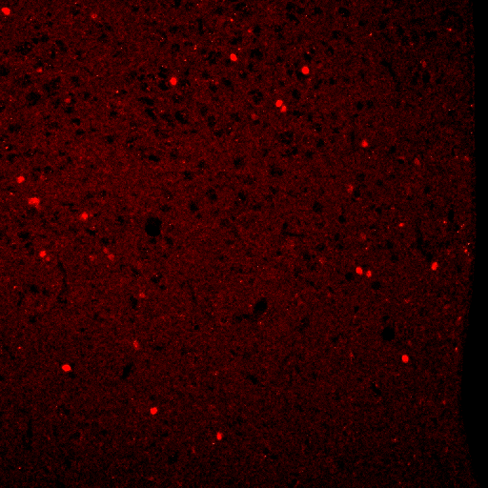
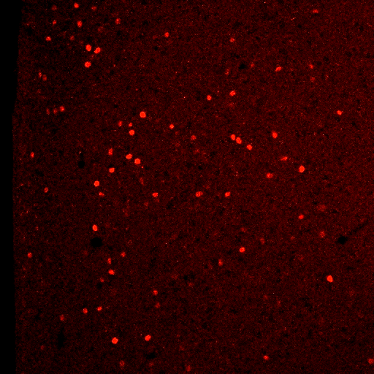
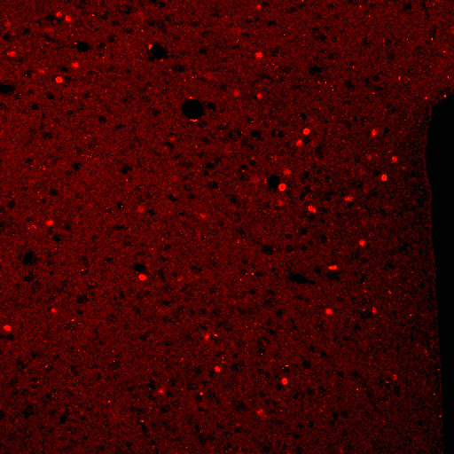
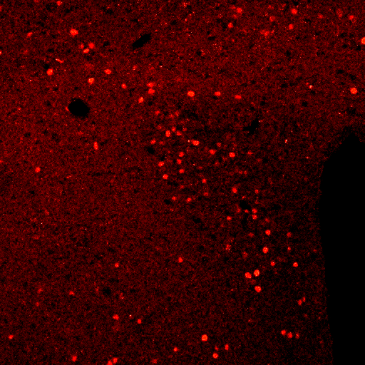
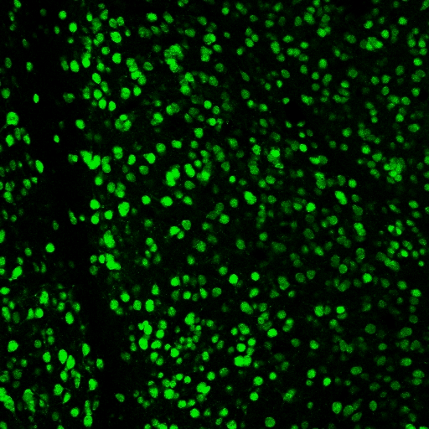
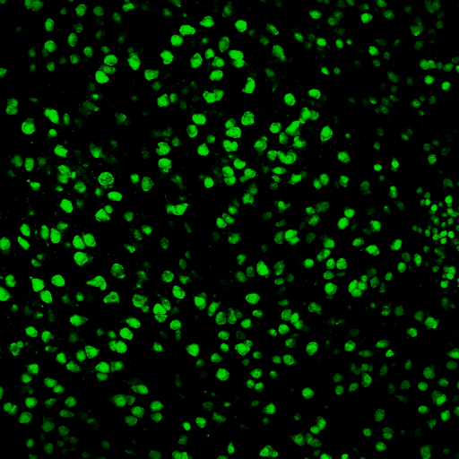
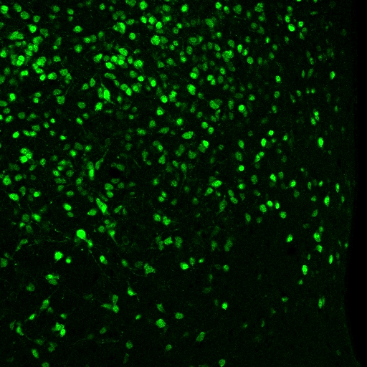
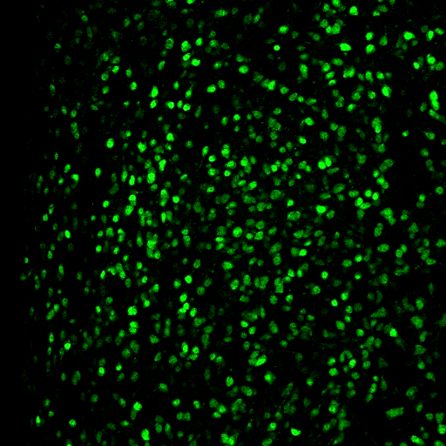
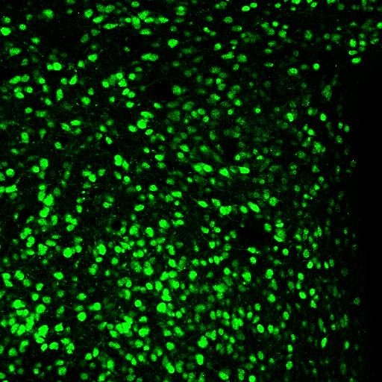
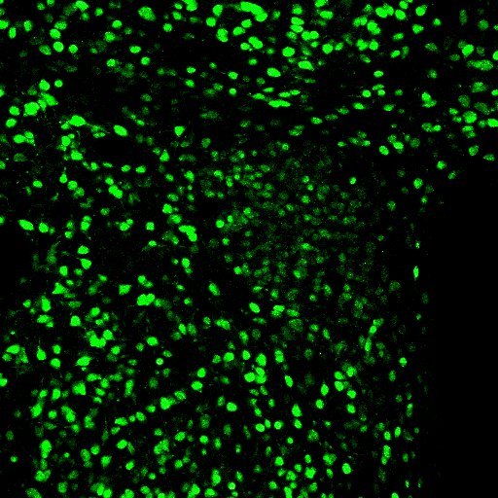
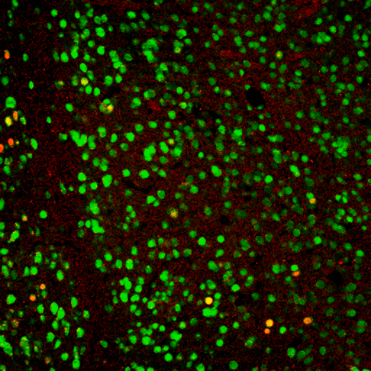
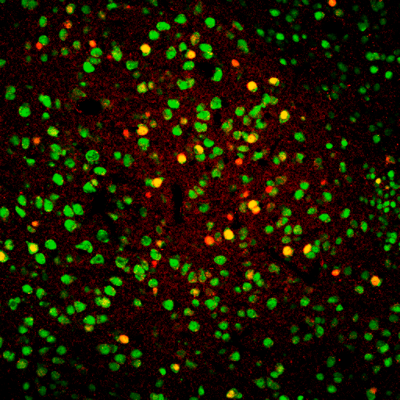
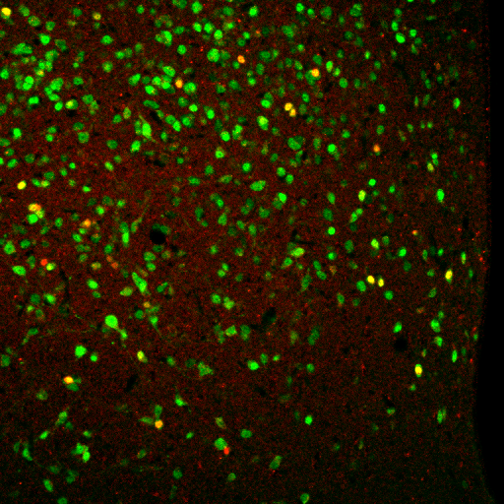
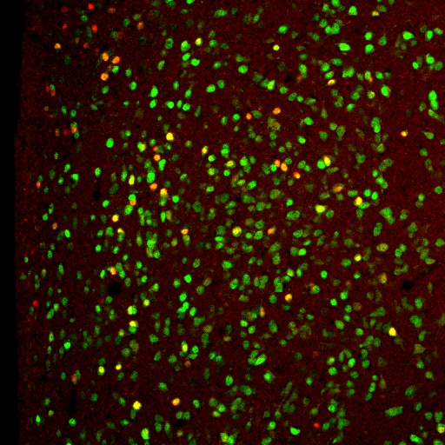
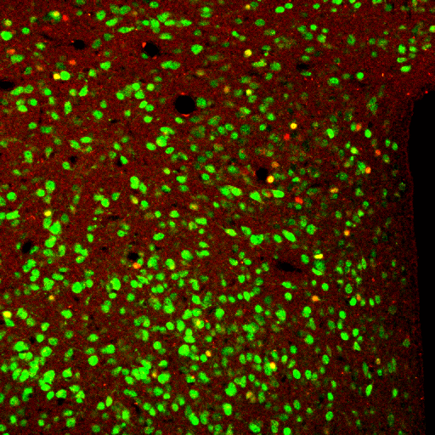
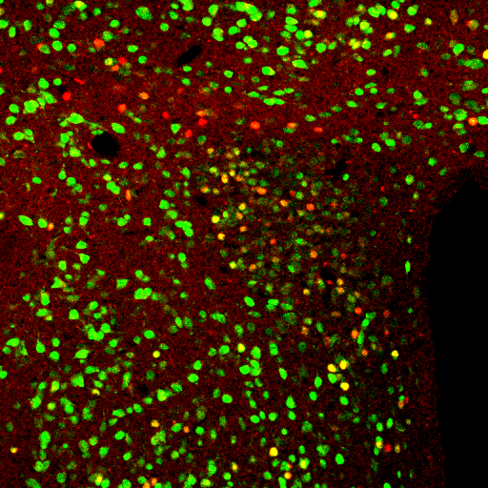
Wei-Li Wu
Basolateral
Amygdala (BLA)
Anterior hypothalamic
nucleus (AH)
Paraventricular nucleus
of the hypothalamus
(PVN)
cFos+
△4EP
4EP+
△4EP
4EP+
△4EP
4EP+
c-Fos
NeuN
c-Fos-NeuN
100uM
100uM
100uM
Notes:
We tried to look at this another way and took similarly co-colonized mice and exposed them to a behavior test and then harvested the brain and stained for the neuronal activation marker, c-Fos. Here we’ve stained for c-Fos in red, neuN as a pan-neuronal marker in green, and then the merge here at the bottom. I hope you can see these representative images, and then the quantified data along the top. We see increases in c-Fos staining in the amygdala and hypothalamus again.
and we tested many other brain regions without seeing a difference.
We continue to explore the mechanistic details of this pathway.

Slide 23
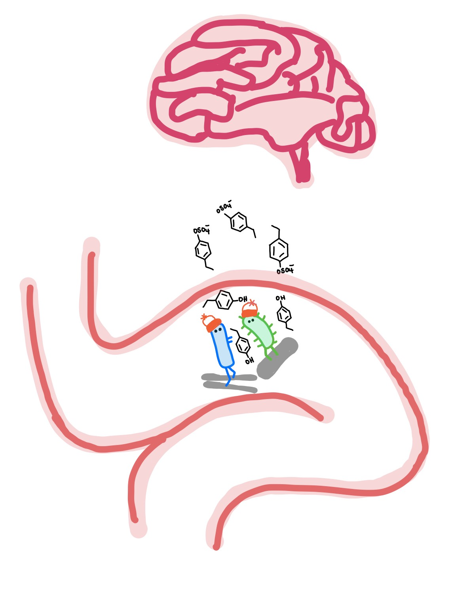
Conclusion
Engineered bacteria producing specific metabolites allow gut exposure
Levels of metabolite production potentially can be controlled
Direct effects of the gut metabolites can be assessed without confounding factors
Certain metabolites have far reaching effects in the host, including in the brain and in behavior

Slide 24

Acknowledgements
Masanoria Funabashi, Michael Fischbach (pathway identification and bacterial engineering)
Zhuo Wang, Daniel Holschneider (autoradiography)
Destanie Rose, Paul Ashwood (provided human and NHP ASD samples)
Metabolon (metabolomics of human and NHP samples)
Wei-Li Wu (Brain sectioning)
Taren Thron (Gnotobiotic manager)
Mark Adame (Technician, Behavior Scoring)
Sarkis Mazmanian
Mazmanian Lab members
Funding:
Center for Environmental Microbial Interactions
NIH 1R01MH100556
Investigating the Gut Microbiome For Novel Therapies and Diagnostics for Autism

